Slide 1
Intro & Conclusion
For informative writing

Slide 2
Introductions
Purpose:
Grab readers attention
Introduce important ideas to the reader
To introduce the central idea or thesis
Contents-your introduction should have (in this order):
Hook
Background
Thesis

Slide 3
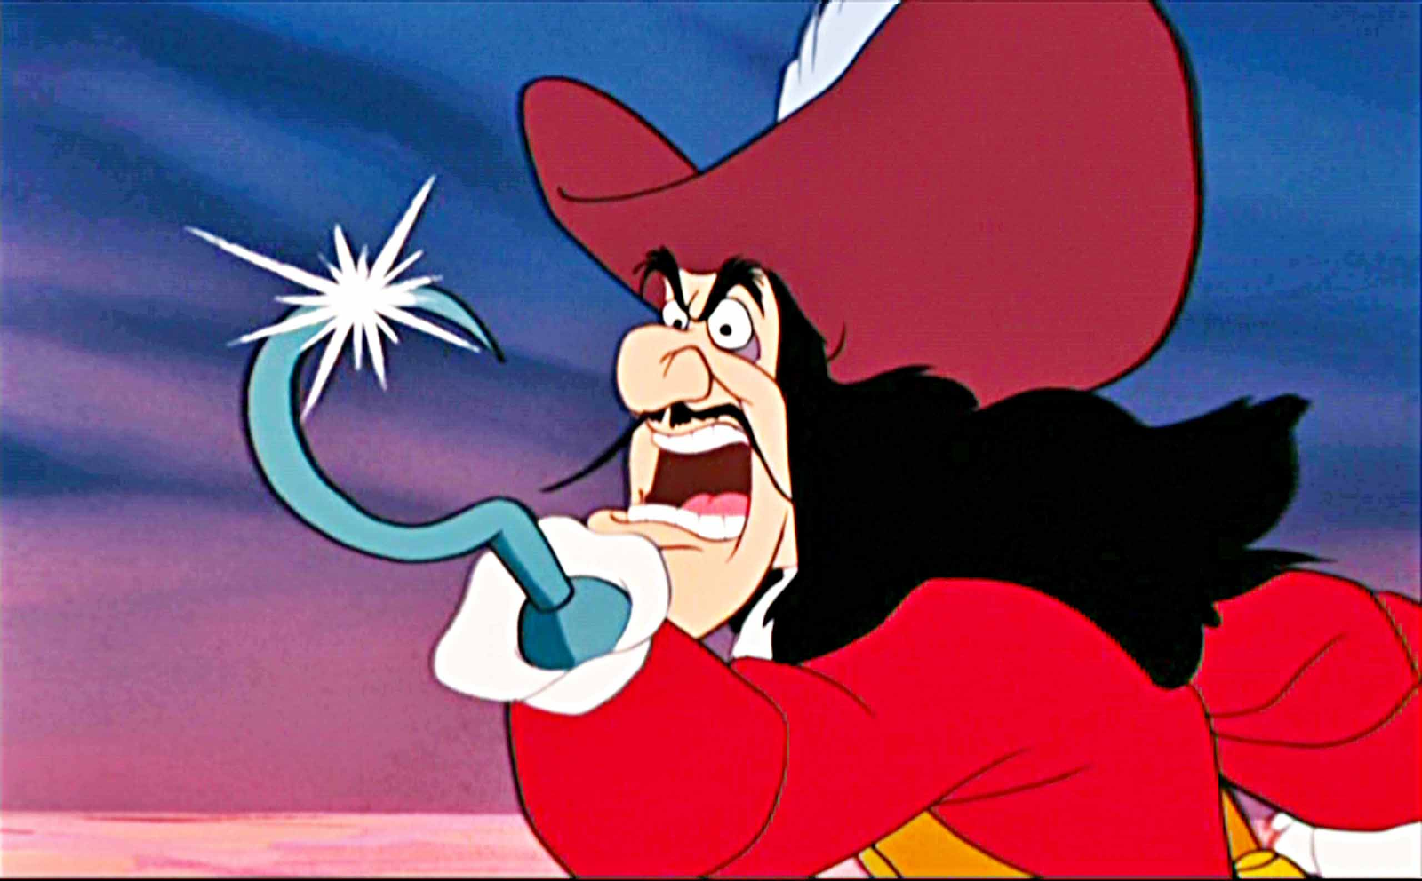
Hook:
Purpose:
Grab readers attention and make them want to read the essay/article
Possible Hooks:
Question
Anecdote or Scene
Quote
Startling Fact, Definition or Statistic

Slide 4
Question:
When starting with a question, it is important to not choose a question that can be answered with a simple yes or no. It must be open ended, meaning the reader may have several answers or extended responses.
Do you like to eat food?
What are your favorite memories that revolved around the dinner table?

Slide 5
Anecdote or Scene
Anecdote is a humorous story or retelling of an event, whereas a scene is a description that puts the reader someone.
In high school, I burned my first pork chop in the microwave and it was only a few weeks ago, during Thanksgiving, that I started the oven on fire.
White flour dusted across the kitchen floor, sticky clumps of sugar cemented to the counter, and the faint smell of chocolate chip cookies rising out of the oven. This the setting we all can enjoy.
Scene
Anecdote

Slide 6
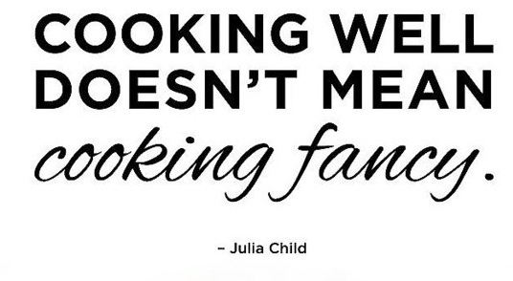
Quote:
When using a quote, it is important to choose one that is specific to your subject. You also need to explain the quote and connect it to your essay. Don’t just put it there and then move on. Which quote below would work best for my article about how to cook.

Slide 7
Fact or Statistic:
When choosing a fact or statistic, think about your reaction to it. Are you surprised by the fact? If not, it may not be the best choice. Choose a fact or statistic that makes your reader say, “REALLY?” or “Wow, I had no idea!”
In the seventies, just over twenty-five percent of Americans’ meals were eaten outside the home. By 2012, this number rose to over forty percent (USDA).
Studies have shown that individuals that eat out often are more likely to be overweight (USDA).

Slide 8
Background
Provide some explanation of your hook and connect it to what is to come in your article/essay. Sort of like a summary, the background may highlight some important ideas that the essay will cover. It also conveys a purpose for the piece of writing.
This fact may startle some restaurant lovers and it may inspire some to even consider cooking more at home. Several people eat out because they don’t enjoy cooking or feel that they cannot do it well. However, it is possible to cook well with a stocked kitchen and a little know how.

Slide 9
Put it all together:
Hook → Background → Thesis
Studies have shown that individuals that eat out often are more likely to be overweight (USDA). This fact may startle some restaurant lovers and it may inspire some to even consider cooking more at home. Several people eat out because they don’t enjoy cooking or feel that they cannot do it well. However, it is possible to cook well with a stocked kitchen and a little know how. Though cooking is challenging, anyone can do it with planning, preparation and creativity.

Slide 10
Conclusion:
Purpose:
Restate the main idea/thesis
Remind the reader of the points main
Bring reader to a close on the subject
Contents-your conclusion should have (in this order):
Restate Thesis in a NEW way
Summarize the body of your essay
Closing Statement to end essay

Slide 11
Put it all together:
Restate Thesis → Summary → Closing Statement
Many people may be intimidated by cooking, but if they are willing to take time to form a plan, as well as keep an open mind, they will succeed. With a variety of kitchen supplies, almost any meal can be made. And with a great plan and the right recipe, a decent meal can be created like a piece of art. Once the basics have been covered and confidence has been gained, a little creativity can make a decent meal great. Who needs to eat out when the finest meals can be had at our own kitchen tables?

